Slide 1
Software Development Life Cycle

Slide 2
Software Development Life Cycle
Software Development Life Cycle (SDLC) offers a systematic process for building as well as delivering software applications.
It is a multistep, iterative process. Development teams rely on a system development life cycle to create software with as little issues as possible.
The generalized version of an SDLC has 6 distinct stages, namely:
Planning,
Analysis,
Designing,
Development & testing,
Implementation
maintenance.
Each of them is briefly explained in the following section.

Slide 3
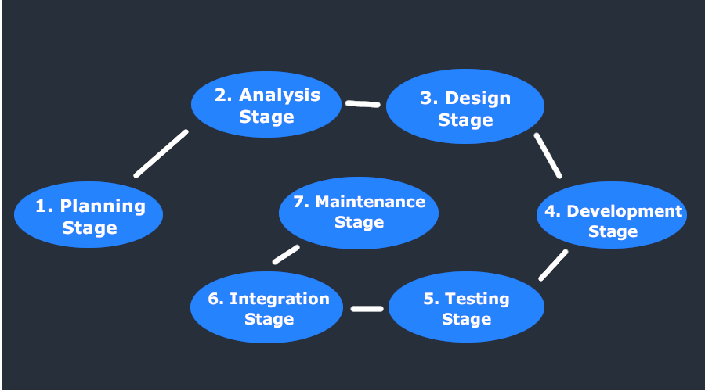

Slide 4
Stage 1 – Planning
The very first phase of the SDLC starts with requirement gathering.
It is the most important phase of the entire SDLC from the perspective of project managers and stakeholders.
The planning stage answers questions such as:
How the software will be used?
What data will serve as the input of the software?
What data will be the output given by the software?
Who is going to use the software?

Slide 5
Stage 2 – Analysis
Once all the requirements are collected, it’s time to analyze those requirements for feasibility and validity.
Simply stating, it is studied whether it will be possible to add the requirements to the software or not.
Lastly, a Requirement Specification documented is made.
It serves as the guide for carrying out the next phase of the SDLC.

Slide 6
Stage 3 – Designing
This stage includes the designing of requirements specified in the very first phase of the SDLC.
In addition to assisting in specifying hardware as well as system requirements, Software Design also helps in defining the overall software architecture.
The system design specifications prepared in the designing phase serve as the input for the next i.e. fourth stage of the SDLC.
During the designing phase, testers are required to come up with an apt testing strategy.
It contains what needs to be tested, and how it needs to be tested.

Slide 7
Stage 4 – Development & Testing
Some development teams consider this phase as a single unit, others prefer to break it into two sub-phases.
Irrespective of the choice a development team makes, the whole process remains the same. So, it’s all a matter of preference.
Once the system design documentation is complete, the whole task is divided into modules or units. Now, the actual coding starts.
Because this phase includes coding, it is the most important phase of the SDLC for the developer team.
This is the longest phase of the entire software development lifecycle.
Once the code is fully developed, testing of the same is carried against the requirements.
During this phase of the SDLC, various types of functional testing, such as acceptance testing, integration testing, system testing, and unit testing, as well as the non-functional testing is carried out.

Slide 8
Stage 5 – Implementation
Also known as the deployment phase,
The implementation phase is carried out right after the successful testing of the software product.
It is simply delivering the software to the end-user or installing it onto the customer’s system(s).
The first thing that takes place once the product is delivered to the customer is beta testing.
All the bugs and enhancements are then reported to the developer team working on the project afterward.
Once all the changes are complete, the final deployment takes place.

Slide 9
Stage 6 – Maintenance
At last, the maintenance phase is executed.
The maintenance stage covers everything that happens after the system is launched. For example, it can include repairs in case of system failures, adding new features, and upgrades.
This phase deals with dealing with problems experienced by the customers/end-users that they experience while using the developed software.
This needs to be done time and again.

Slide 10
Advantages of SDLC:
Better management control over the entire project
Transparency and visibility of all the processes
Clarity of requirements
A single vision of a product for all the parties involved
Predictable results in terms of time, costs, and deliverables
Reduced risk of going off the track

Slide 11
Disadvantages of SDLC:
Due to assumptions made at the start of the project, if different unexpected circumstances complicate the development process, that can lead to more complications in the future.
For instance, if newly applied hardware is not working appropriately, it can increase the costs and the time required for the development.
Several approaches are not flexible.
It may be hard to estimate the overall costs at the start of the project.
Performing testing at the end of the development process can slow down development teams.

Slide 12
TYPES OF SDLC MODELS

Slide 13
What is the best SDLC model? Here are six to consider:
Waterfall Model
V-Shaped Model
Iterative Model
Spiral Model
Big Bang Model
Agile Model

Slide 14
1. The Waterfall Model(1970-90)
It is also referred to as a linear sequential life cycle model. It is very simple to understand and use.
In a waterfall model, each phase must be completed before the next phase can begin and there is no overlapping in the phases.
Waterfall model is the earliest SDLC approach that was used for software development .
The waterfall Model illustrates the software development process in a linear sequential flow; hence it is also referred to as a linear-sequential life cycle model.
This means that any phase in the development process begins only if the previous phase is complete. In waterfall model phases do not overlap.

Slide 15
Waterfall Model design
Waterfall approach was first SDLC Model to be used widely in Software Engineering to ensure success of the project.
In "The Waterfall" approach, the whole process of software development is divided into separate phases.
In Waterfall model, typically, the outcome of one phase acts as the input for the next phase sequentially.

Slide 16
Different phases of waterfall model.

Slide 17
The sequential phases in Waterfall model are:
Requirement Gathering and analysis:
All possible requirements of the system to be developed are captured in this phase and documented in a requirement specification doc.
System Design:
The requirement specifications from first phase are studied in this phase and system design is prepared.
System Design helps in specifying hardware and system requirements and also helps in defining overall system architecture.
Implementation:
With inputs from system design, the system is first developed in small programs called units, which are integrated in the next phase.
Each unit is developed and tested for its functionality which is referred to as Unit Testing.

Slide 18
Integration and Testing:
All the units developed in the implementation phase are integrated into a system after testing of each unit.
Post integration the entire system is tested for any faults and failures.
Deployment of system:
Once the testing is done, the product is deployed in the customer environment or released into the market.
Maintenance:
There are some issues which come up in the client environment.
To fix those issues patches are released. Also to enhance the product some better versions are released.
Maintenance is done to deliver these changes in the customer environment

Slide 19
All these phases are cascaded to each other in which progress is seen as flowing steadily downwards like a waterfall through the phases.
The next phase is started only after the defined set of goals are achieved for previous phase and it is signed off, so the name "Waterfall Model". In this model phases do not overlap.

Slide 20
Waterfall Model Application
Every software developed is different and requires a suitable SDLC approach to be followed based on the internal and external factors.
Some situations where the use of Waterfall model is most appropriate are:
Requirements are very well documented, clear and fixed.
Product definition is stable.
Technology is understood and is not dynamic.
There are no ambiguous requirements.
Ample resources with required expertise are available to support the product.
The project is short.

Slide 21
Advantages of waterfall model
This model is simple and easy to understand and use.
It is easy to manage due to the rigidity of the model – each phase has specific deliverables and a review process.
In this model phases are processed and completed one at a time. Phases do not overlap.
Waterfall model works well for smaller projects where requirements are clearly defined and very well understood.

Slide 22
Disadvantages of waterfall model
Once an application is in the testing stage, it is very difficult to go back and change something that was not well-thought out in the concept stage.
High amounts of risk and uncertainty.
Not a good model for complex and object-oriented projects.
Poor model for long and ongoing projects.
Not suitable for the projects where requirements are at a moderate to high risk of changing.
Cannot accommodate changing requirements.

Slide 23
When to use the waterfall model
This model is used only when the requirements are very well known, clear and fixed.
Product definition is stable.
Technology is understood.
There are no ambiguous requirements
NOTE:
In Waterfall model, very less customer interaction is involved during the development of the product. Once the product is ready then only it can be demonstrated to the end users.
Once the product is developed and if any failure occurs then the cost of fixing such issues are very high, because we need to update everything from document till the logic.

Slide 24
2. V--MODEL
The V - model is SDLC model where execution of processes happens in a sequential manner in V shape.
It is also known as Verification and Validation model.
V - Model is an extension of the waterfall model and is based on association of a testing phase for each corresponding development stage.
This means that for every single phase in the development cycle there is a directly associated testing phase.
This is a highly disciplined model and next phase starts only after completion of the previous phase.

Slide 25
V- Model design
Under V-Model, the corresponding testing phase of the development phase is planned in parallel.
So there are VERIFICATION PHASES on one side of the .V. and VALIDATION PHASES on the other side.
CODING PHASE joins the two sides of the V-Model.

Slide 26
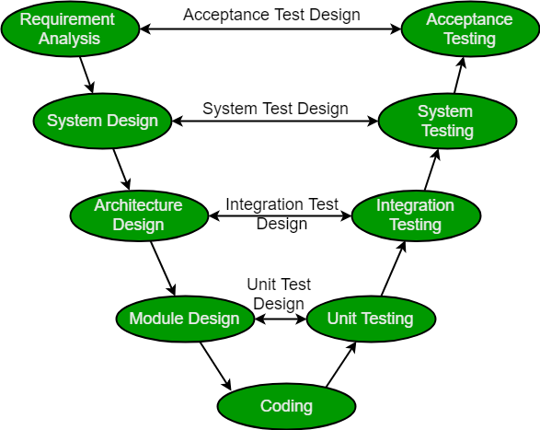

Slide 27
Verification Phases
Following are the Verification phases in V-Model:
Business Requirement Analysis:
This is the first phase in the development cycle where the product requirements are understood from the customer perspective.
This phase involves detailed communication with the customer to understand his expectations and exact requirement.
The acceptance test design planning is done at this stage as business requirements can be used as an input for acceptance testing.

Slide 28
System Design:
Once you have the clear and detailed product requirements, it's time to design the complete system.
System design would comprise of understanding and detailing the complete hardware and communication setup for the product under development.
Architectural Design:
Architectural specifications are understood and designed in this phase.
Usually more than one technical approach is proposed and based on the technical and financial feasibility the final decision is taken.
System design is broken down further into modules taking up different functionality.
This is also referred to as High Level Design HLD.

Slide 29
Module Design:
In this phase the detailed internal design for all the system modules is specified, referred to as Low Level Design LLD.
It is important that the design is compatible with the other modules in the system architecture and the other external systems.
Unit tests are an essential part of any development process and helps eliminate the maximum faults and errors at a very early stage.
Unit tests can be designed at this stage based on the internal module designs.

Slide 30
Coding Phase
This is at the bottom of the V-Shape model. Module design is converted into code by developers.
The best suitable programming language is decided based on the system and architectural requirements.
The coding is performed based on the coding guidelines and standards.
Unit Testing is performed by the developers on the code written by them.

Slide 31
Validation Phases
Following are the Validation phases in V-Model:
Unit Testing:
Unit tests designed in the module design phase are executed on the code during this validation phase.
Unit testing is the testing at code level and helps eliminate bugs at an early stage, though all defects cannot be uncovered by unit testing.
Integration Testing:
Integration testing is associated with the architectural design phase.
Integration tests are performed to test the coexistence and communication of the internal modules within the system

Slide 32
System Testing:
System testing is directly associated with the System design phase.
System tests check the entire system functionality and the communication of the system under development with external systems.
Most of the software and hardware compatibility issues can be uncovered during system test execution.
Acceptance Testing:
Acceptance testing is associated with the business requirement analysis phase and involves testing the product in user environment.
Acceptance tests uncover the compatibility issues with the other systems available in the user environment.
It also discovers the non functional issues such as load and performance defects in the actual user environment.

Slide 33
V- Model Application
V- Model application is almost same as waterfall model, as both the models are of sequential type.
This model is used in the medical development field, as it is strictly disciplined domain.
Following are the suitable scenarios to use V-Model:
Requirements are well defined, clearly documented and fixed.
Product definition is stable.
Technology is not dynamic and is well understood by the project team.
There are no ambiguous or undefined requirements.
The project is short

Slide 34
Advantages of V-model:
Simple and easy to use.
Testing activities like planning, test designing happens well before coding. This saves a lot of time. Hence higher chance of success over the waterfall model.
Proactive defect tracking – that is defects are found at early stage.
Avoids the downward flow of the defects.
Works well for small projects where requirements are easily understood.

Slide 35
Disadvantages of V-model:
Very rigid and least flexible.
Software is developed during the implementation phase, so no early prototypes of the software are produced.
If any changes happen in midway, then the test documents along with requirement documents has to be updated

Slide 36
When to use the V-model:
The V-shaped model should be used for small to medium sized projects where requirements are clearly defined and fixed.
The V-Shaped model should be chosen when ample technical resources are available with needed technical expertise.
High confidence of customer is required for choosing the V-Shaped model approach. Since, no prototypes are produced, there is a very high risk involved in meeting customer expectations.

